Slide 1
WorldVisitz Mobile Application Agile Delivery Launch
Agile Onboarding - Presentation for the Agile Team
Presented by: Okba Zebir
© 2019 Udacity. All rights reserved.

Slide 2
Onboarding the Team

Slide 3
Agile Benefits for the Team
Focus on Value - Agile is driven by the goal of delivering maximum business value that is aligned with the organization’s vision.
Self-Organized Teams - Agile Teams have the autonomy to make some de-centralized decisions, which allows for shared ownership of the work.
Constructive Conflict Resolution - Conflicts in Agile Teams are constructively resolved because the team is driven by a shared vision.
Innovation Hub - Agile Teams, with diverse and cross-functional skill sets, are an innovation hub that spurs solutions.
Cultivate Mastery - Time is put aside in Agile Teams for learning and growth. This allows Agile Team members to sharpen their skills.

Slide 4
Agile Practice

Slide 5
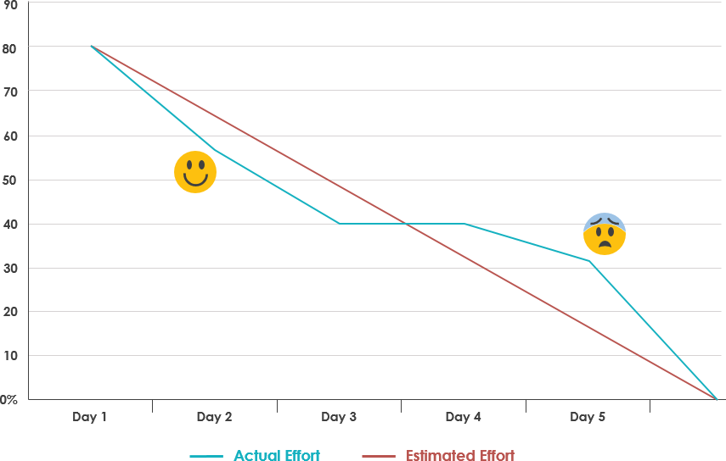
Recommendations for Information Radiators
Burn-down chart: is a visual measurement tool that represents
The work left to do versus time. its purpose is to enable
the project to be on track to deliver the expected solution
with the desired schedule.
Some of the benefits of a Burn-down chart:
Recognize completed work by measuring the project completion.
Articulate any obstacles that face the team’s progress.
Easy to understand and create

Slide 6
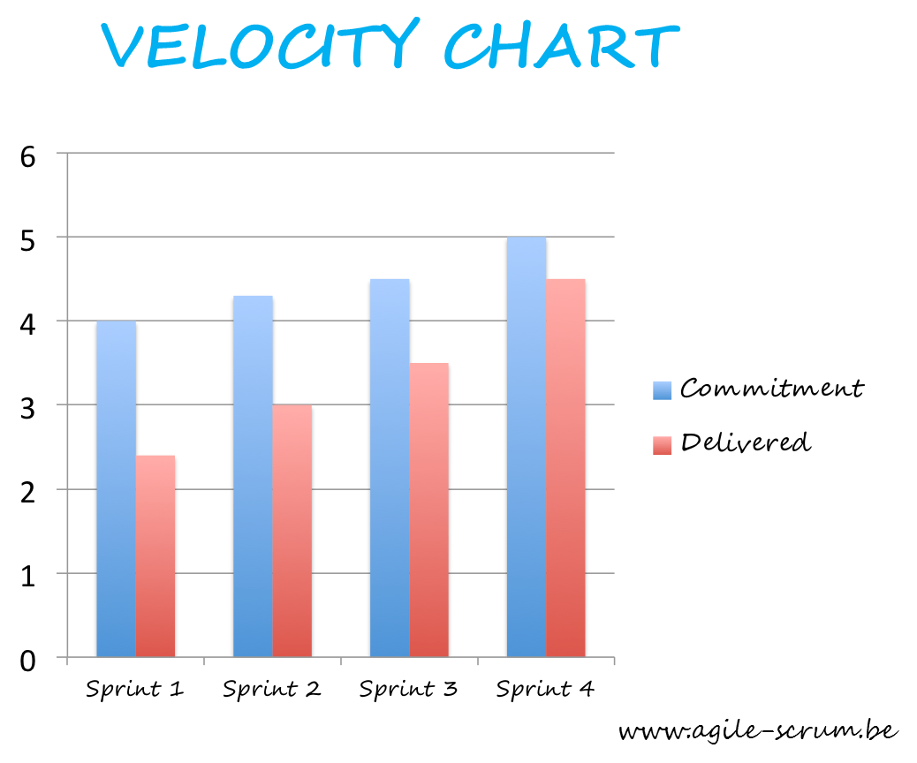
Velocity Chart
Velocity chart: is a graphical representation of the amount of
Work completed (story points) by the team during each sprint.
Velocity chart benefits :
Display the average amount of work a scrum team
completes during a sprint.
Help you make better predictions about your team capacity
Highlight issues before they become problems.

Slide 7
Ceremony Schedule & Each Agenda
Scrum Ceremony | Agenda | Schedule
Project vision | Discuss goals, sponsor, vision, success criteria, assumptions, and risks. | Once per Project Time-boxed to 1 Hour
Release Planning | Discuss critical dates and milestones, coordinate with dependent systems, and balance business value versus quality. | Once per release after initial creation. Time-boxed to 20mins.
Sprint Planning | Create sprint backlog. Task planning. Task level estimated. | A few times per sprint. Time-boxed to 8hours per sprint .

Slide 8
Scrum ceremony | Agenda | schedule
Daily Stand-Ups | Each team member answers 3 questions. What did I do since the last time we met? What do I plan to accomplish today? What impediments am I encountering? | Held daily preferably in the morning. Time-boxed to 15 minutes
Sprint Review and Demo | Team presents completed sprint deliverables to PO based on Acceptance criteria and DoD. | Once per sprint Time-boxed to 4 hours per sprint .
Retrospective | Discuss what went well during thesprint, as well as opportunities for improvement. | Once per sprint. Time-boxed to 3 hours per sprint .

Slide 9
High Performing Agile Teams

Slide 10
Team Composition and Role Assignments
Team Member | Current title | Scrum Role | Responsibilities | Soft Skills
Jane Doe | Project Manager | Scrum Master | Ensuring the team follows agile values and principles. Remove impediments, ensure a good relationship between the team and PO. Keeps the team on Track, plans and leads meetings. | Leadership, communication, problem-solving, and emotional intelligence
John Smith | Product Manager | Product Owner | Create and maintain the product backlog, prioritizing items. Communicating the vision, goals, and strategy to the customers, stakeholders and team. | Domain knowledge, strategic thinking, communication, and interpersonal skills.
Jerry Holden | Business Analyst | Development Team Member | Collaborates with Product Owner to define product, customer, and stakeholders requirements, and clarifies requirements for the development team. | Domain knowledge, analytical thinking, communication,
James Cowx | UX Designer | Development Team Member | Delivering a releasable increment of the product, estimating the effort required to complete the work, collaborate with other developers, and participating in Scrum events. | Presentation skills, Creativity, attention to detail, communication and Storytelling
Holly Vogt | Subject Matter Expert | Development Team Member | Provides guidance and expertise on specific areas, collaborates with the development team to implements | Domain knowledge, communication, problem-solving
Jim Brady (USA) | Developer | Development Team Member | Delivering a releasable increment of the product, estimating the effort required to complete the work, collaborate with other developers, and participating in Scrum events. | Communication, Technical expertise, team collaboration, problem-solving
Nathan Connor (USA) | Developer | Development Team Member | Delivering a releasable increment of the product, estimating the effort required to complete the work, collaborate with other developers, and participating in Scrum events. | Communication, Technical expertise, team collaboration, problem-solving
Venkat Ragu (India) | Developer | Development Team Member | Delivering a releasable increment of the product, estimating the effort required to complete the work, collaborate with other developers, and participating in Scrum events. | Communication, Technical expertise, team collaboration, problem-solving
Ali Khan (India) | Developer | Development Team Member | Delivering a releasable increment of the product, estimating the effort required to complete the work, collaborating with other developers, and participating in Scrum events. | Communication, Technical expertise, team collaboration, problem-solving
Kathy Qualls | Tester | Development Team Member | Tests product increments, collaborates with other team members, | Attention to detail, critical thinking, communication

Slide 11
Appendix 1 - Skill Gaps
Identifies current weaknesses and antipatterns in the team
Role | Weakness and Skills Gap
Scrum master | Direct and manage the Team devs, Lack of help the team and remove impediments. Lack of experience in coaching Agile principals
Product Owner | Determining the requirement for whole the product early. Detailed project plan. Less collaboration with the customers to collect feedback.
Developers and Tester | Lack of collaboration with team, and transfer of knowledge. Lack of consistent coding standards. Lack of self-organized, Limited knowledge and experience of Agile development practices.
Business Analysis | Determining the requirement for whole the product early. Limited knowledge and experience of Agile development practices.
Subject Matter Expert | Limited knowledge and experience of Agile development practices.
UX Designer | Lack of collaboration team, Lack of self-organized and Limited knowledge and experience of Agile development practices.

Slide 12
Appendix 2 –Training & Coaching Plan
I recommend the following training and coaching plan:
For the developers, tester, and UX designer: One-on-One coaching following the Shu Ha Ri model to develop and provide a good understanding of agile practices and how to implement them in their work journey.
For the offshore developer, business analyst, and subject matter expert: provide Dreyfus Model to train and coach them about agile practices

